Slide 1
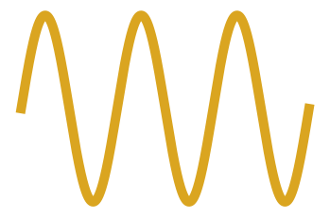

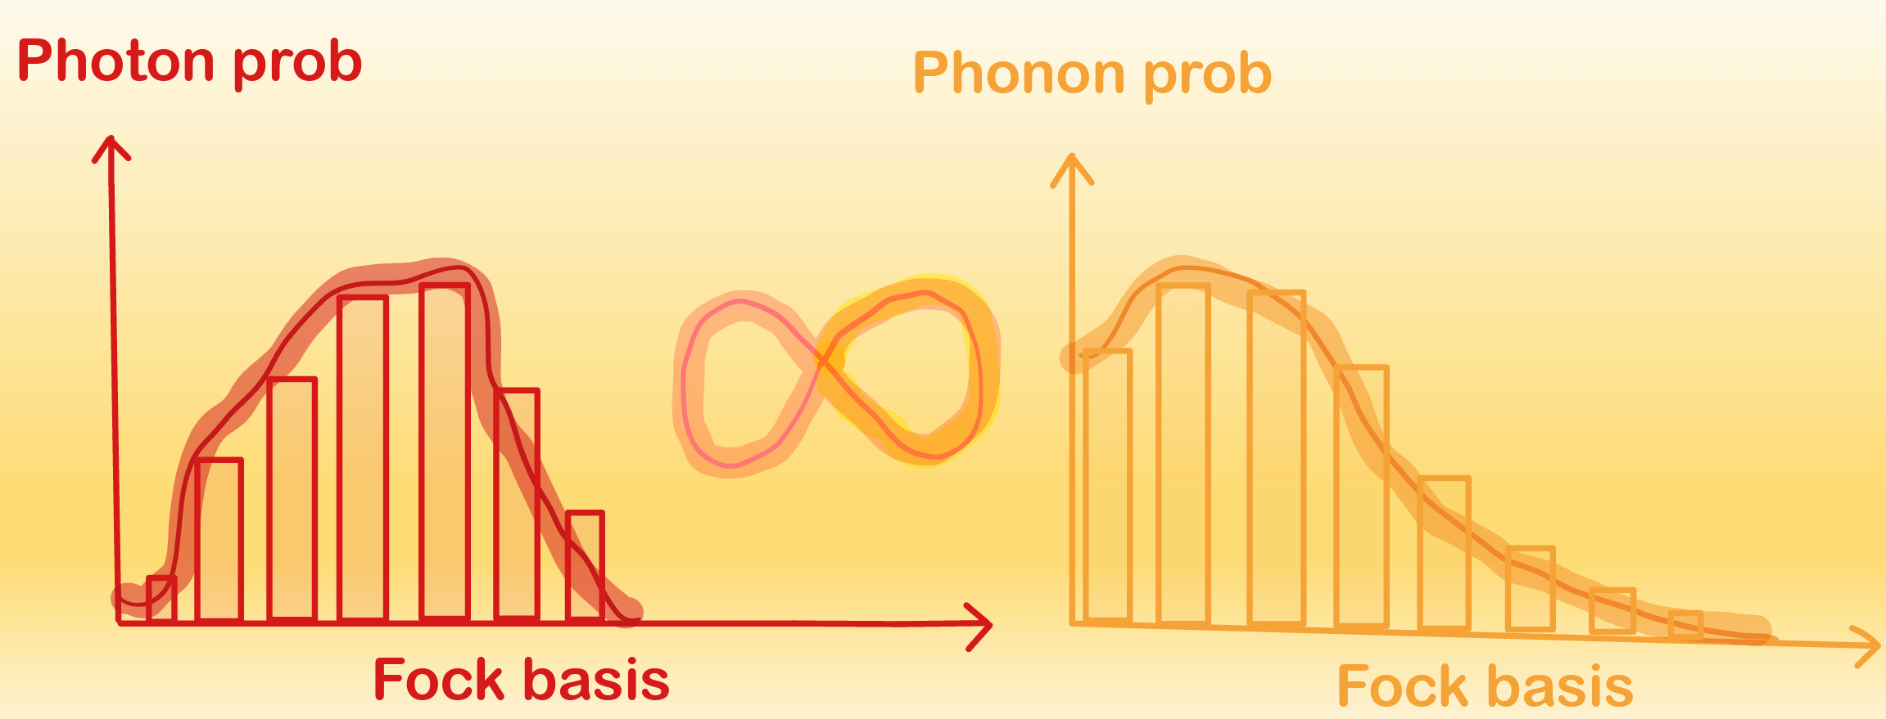

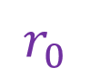
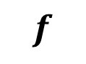

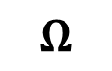

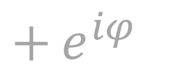





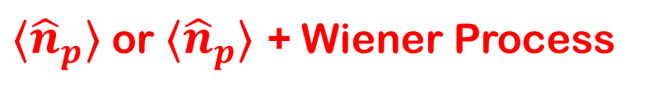
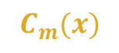
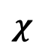


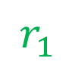
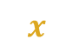


$$Ω$$
$$χ$$
$$f$$
$$r_{0}$$
$$f_{MP}$$
$$C_{q}$$
$$r_{1}$$
$$L$$
$$C$$
$$x$$
$$R_{c}$$
$$R_{m}$$
$$C_{m}(x)$$
Multiplexing qubit
WCM
Agent
Observation: O =
${⟨\hat{n}}_{p}⟩$ or ${⟨\hat{n}}_{p}⟩$ + Wiener Process
Action
Critic
Actor
Reward: R =
$$−\left|\text{O}−{⟨\hat{n}}_{p}^{target}⟩\right|$$
Entanglement in nonlinear interaction
Entanglement in linear interaction
$$| ⟩$$
$$| ⟩$$
$$| ⟩$$
~
$+$ $e^{iφ}$

